Slide 1
Introduction to Data Analytics
Tutorial #1
R Installation
Dr. Sreeja S R
Assistant Professor
Indian Institute of Information Technology
IIIT Sri City

Slide 2

Quote of the day..
What we think, we become.
Gautama Buddha, Sege

Slide 3

Today’s discussion…
R is an open source programming language and software environment for statistical computing and graphics.
The R language is widely used among statisticians and data miners for developing statistical software and data analytics tools

Slide 4
History of R
Modelled after S & S-plus, developed at AT&T labs in late 1980s.
R project was started by Robert Gentleman and Ross Ihaka Department of Statistics, University of Auckland (1995).
Currently maintained by R core development team – an international team of volunteer developers (since 1997).

Slide 5
Features of R Programming
R is a open source programming language. R possesses an extensive catalogue of statistical and graphical methods.
It includes machine learning algorithms, linear regression, time series, statistical inferences.
Most of the R libraries are written in R, but for heavy computational tasks, C, C++ and Fortran codes are preferred.
R is not only entrusted by academic, but many large companies also use R programming language, including Uber, Google, Airbnb, Facebook and so on.

Slide 6
Features of R Programming
Comprehensive Environment
Can Perform Complex Statistical Calculations
Distributed Computing
Running Code Without a Compiler
Data Variety
Data Handling and Storage
Vector Arithmetic
Generates Report in any Desired Format

Slide 7
R resources
http://www.r-project.org/
http://cran.r-project.org/doc/contrib/Verzani-SimpleR.pdf

Slide 8
Download R and RStudio
Download R :
http://cran.r-project.org/bin/
Download RStudio :
http://www.rstudio.com/ide/download/desktop

Slide 9
Installation
Installing R on windows PC :
Use internet browser to point to : http://mirror.aarnet.edu.au/pub/CRAN
Under the heading Precompiled Binary Distributions, choose the link Windows.
Next heading is R for Windows; choose the link base.
Click on download option(R 3.4.1 for windows).
Save this to the folder C:\R on your PC.
When downloading is complete, close or minimize the Internet browser.
Double click on R 3.4.1-win32.exe in C:\R to install.
Installing R on Linux:
sudo apt-get install r-base-core

Slide 10
Installation
Installing RStudio:
Go to www.rstudio.com and click on the "Download RStudio" button.
Click on "Download RStudio Desktop.“
Click on the version recommended for your system, or the latest Windows version, and save the executable file. Run the .exe file and follow the installation instructions.

Slide 11
Version
Get R version
R.Version()
Get RStudio version
RStudio: Toolbar at top > Help > About RStudio

Slide 12
A test run with R in Windows
Double click the R icon on the Desktop and the R Console will open.
Wait while the program loads. You observe something like this.
You can type your own program at the prompt line >.

Slide 13
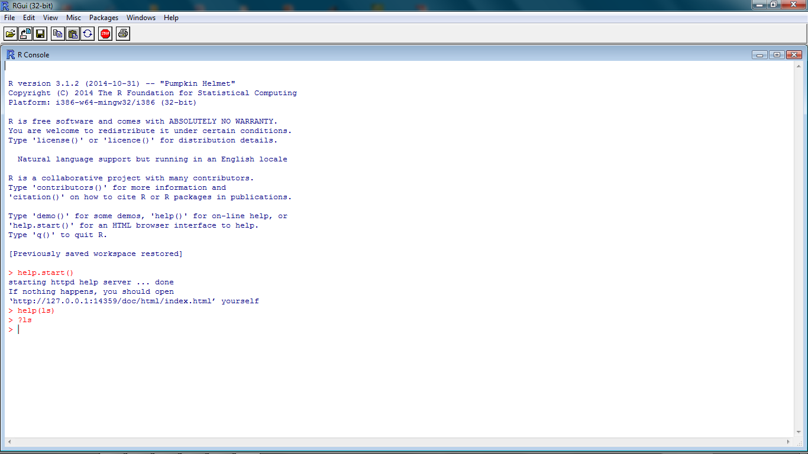
Getting help from R console
help.start()
help(topic)
?topic
??topic

Slide 14
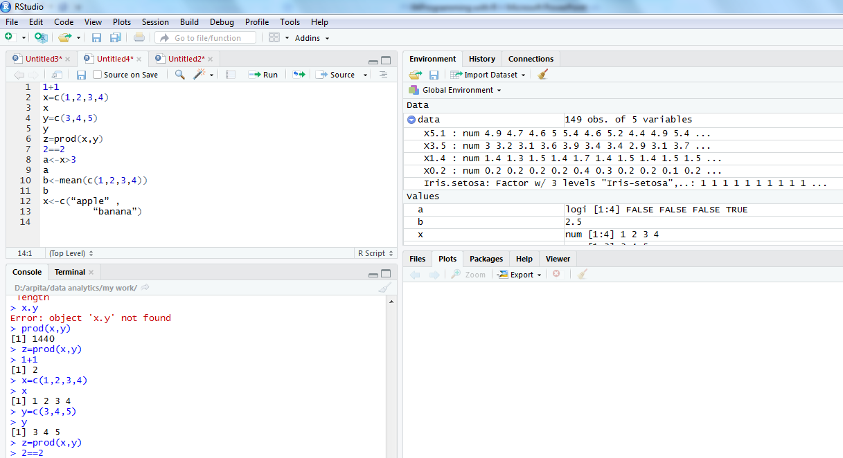
R command in integrated environment

Slide 15
How to use R for simple maths
> 3+5
> 12 + 3 / 4 – 5 + 3*8
> (12 + 3 / 4 – 5) + 3*8
> pi * 2^3 – sqrt(4)
>factorial(4)
>log(2,10)
>log(2, base=10)
>log10(2)
>log(2)
Note
R ignores spaces

Slide 16
How to store results of calculations for future use
> x = 3+5
> x
> y = 12 + 3 / 4 – 5 + 3*8
> y
> z = (12 + 3 / 4 – 5) + 3*8
> z
> A <- 6 + 8 ## no space should be between < & -
> a ## Note: R is case sensitive
>A

Slide 17
Identifiers naming
Don't use underscores ( _ ) or hyphens ( - ) in identifiers.
The preferred form for variable names is all lower case letters and words separated with dots (variable.name) but variableName is also accepted.
Examples: avg.clicks GOOD avgClicks OK avg_Clicks BAD
Function names have initial capital letters and no dots (e.g., FunctionName).

Slide 18
Any question?

